Slide 1
Deep Learning
Lecture 5: Generative Adversarial,
Variational and Implicit Models

Slide 2
Lecture Overview
Unsupervised training
PixelRNN and PixelCNN
Generative models
Generative adversarial networks
Definition
Common Issues
Lipschits Continuity
Spectral Normalisation
Conditional GANs
Other Advanced Variants
Variational autoencoders
Autoencoders
VAEs
Reparameterisation trick
ELBO
Implicit networks
Definition
SIRENs
NeRFs

Slide 3
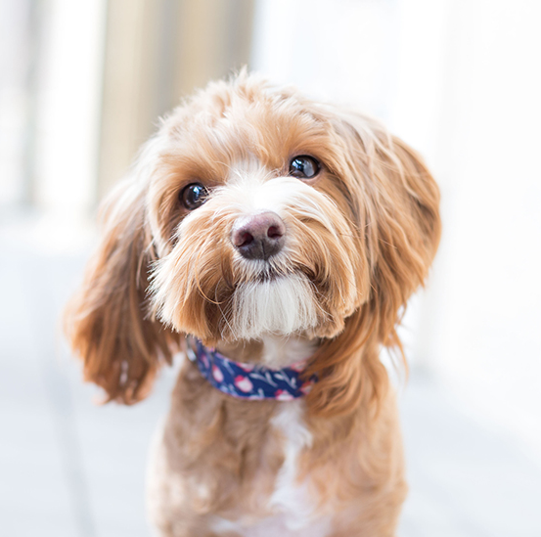

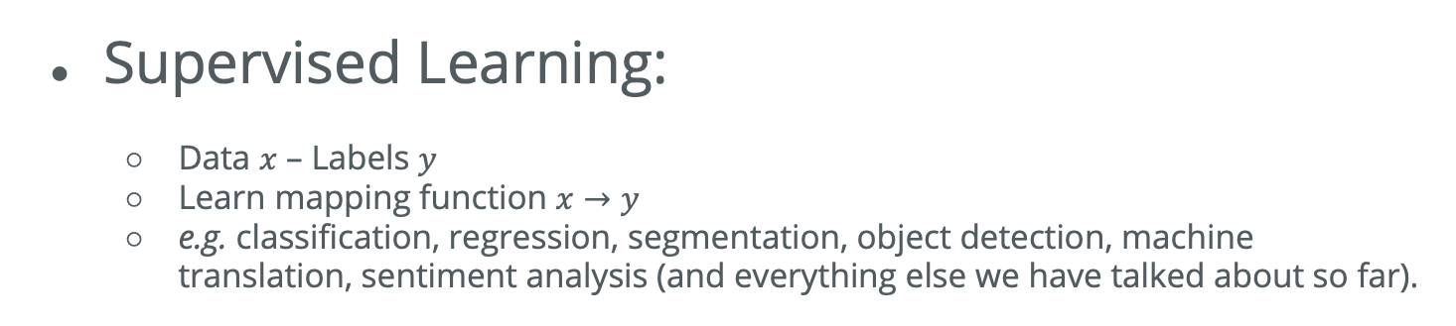
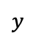
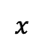
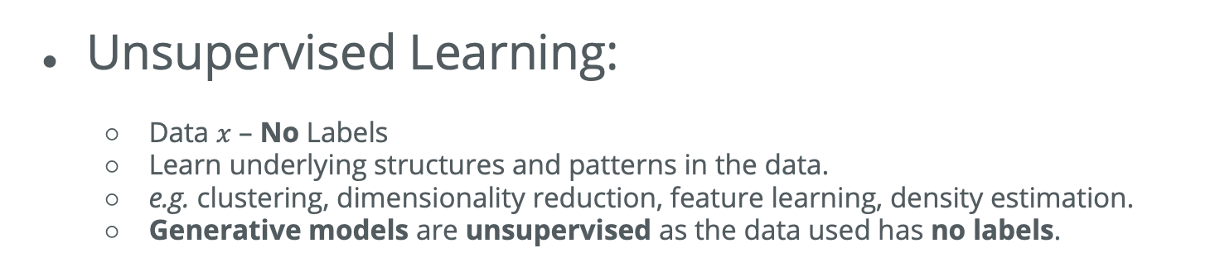
Supervised vs Unsupervised Training
$$x$$
Supervised Learning:
Data $x$ – Labels $y$
Learn mapping function $x→y$
e.g. classification, regression, segmentation, object detection, machine translation, sentiment analysis (and everything else we have talked about so far).
Classification
$$y$$
Dog
Unsupervised Learning:
Data $x$ – No Labels
Learn underlying structures and patterns in the data.
e.g. clustering, dimensionality reduction, feature learning, density estimation.
Generative models are unsupervised as the data used has no labels.
Clustering

Slide 4


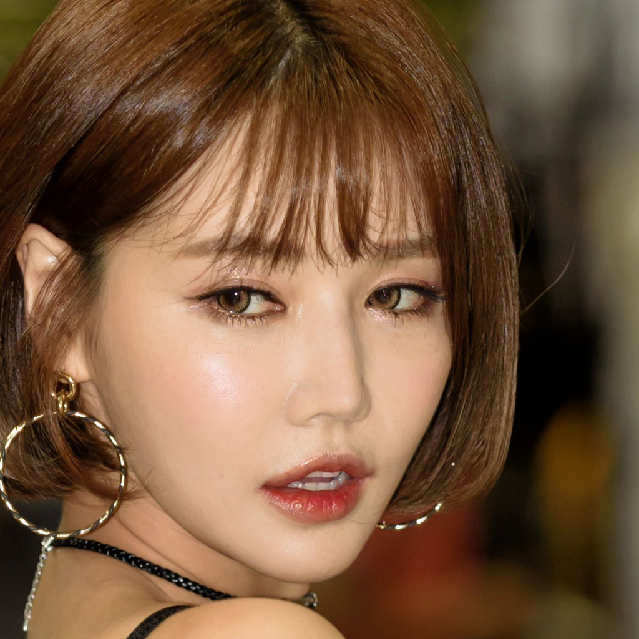
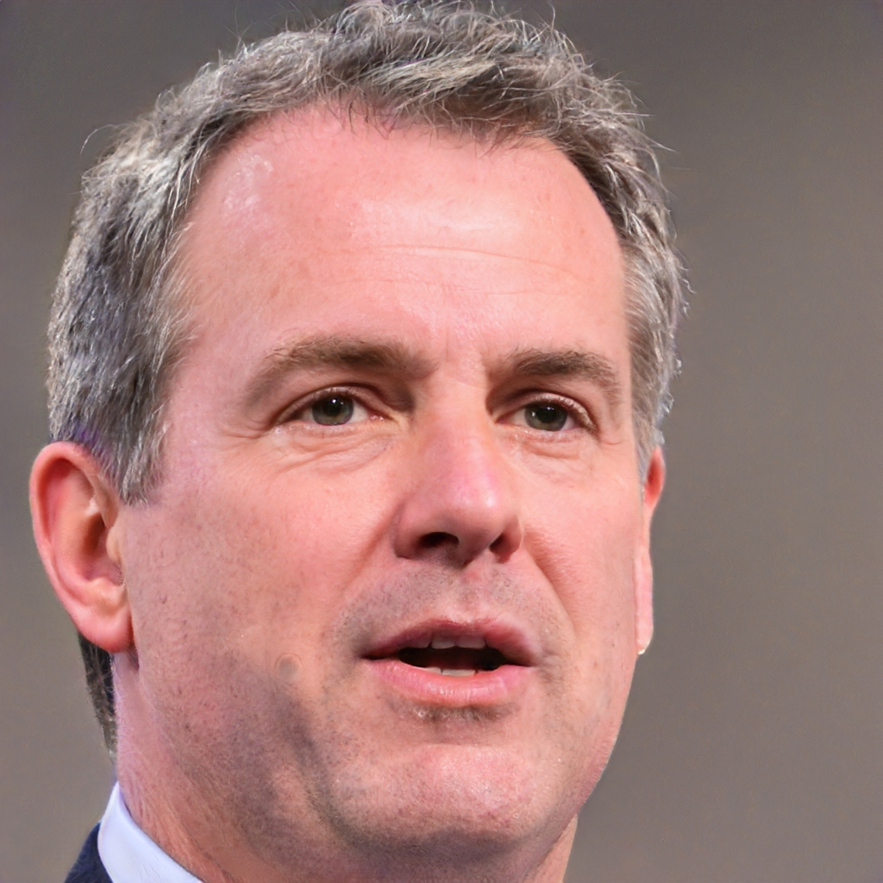
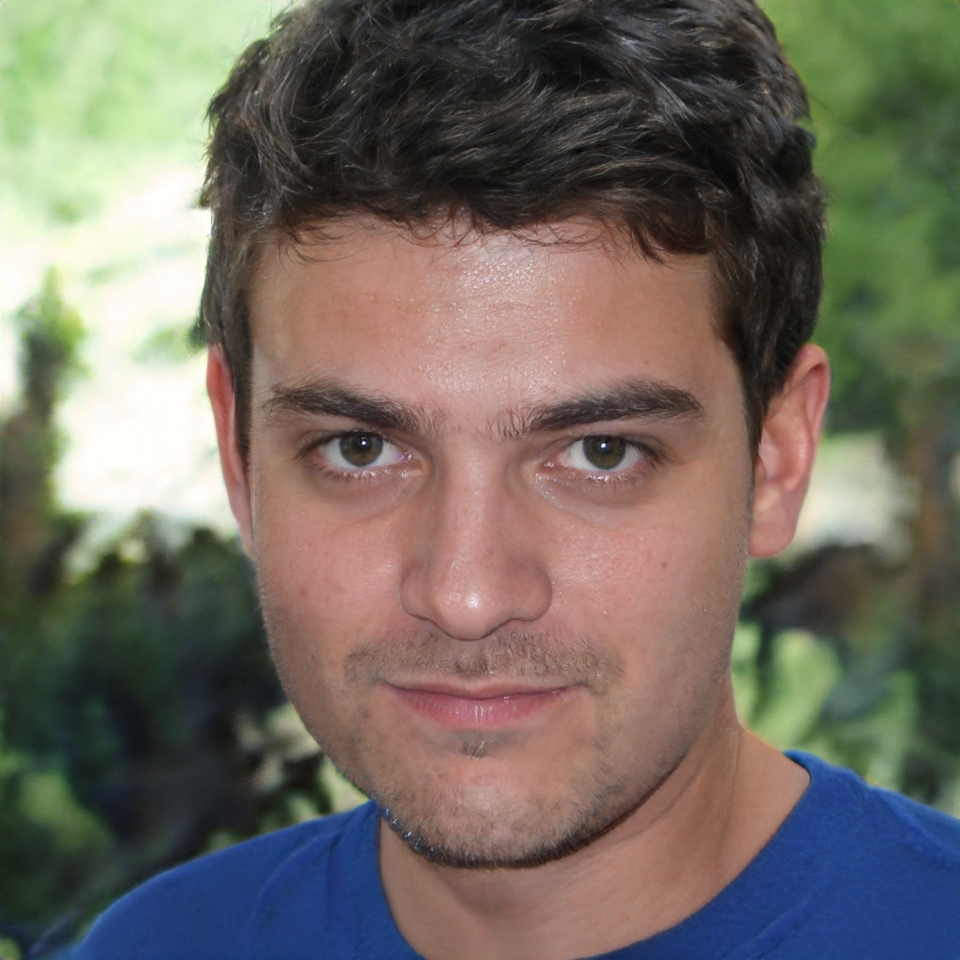

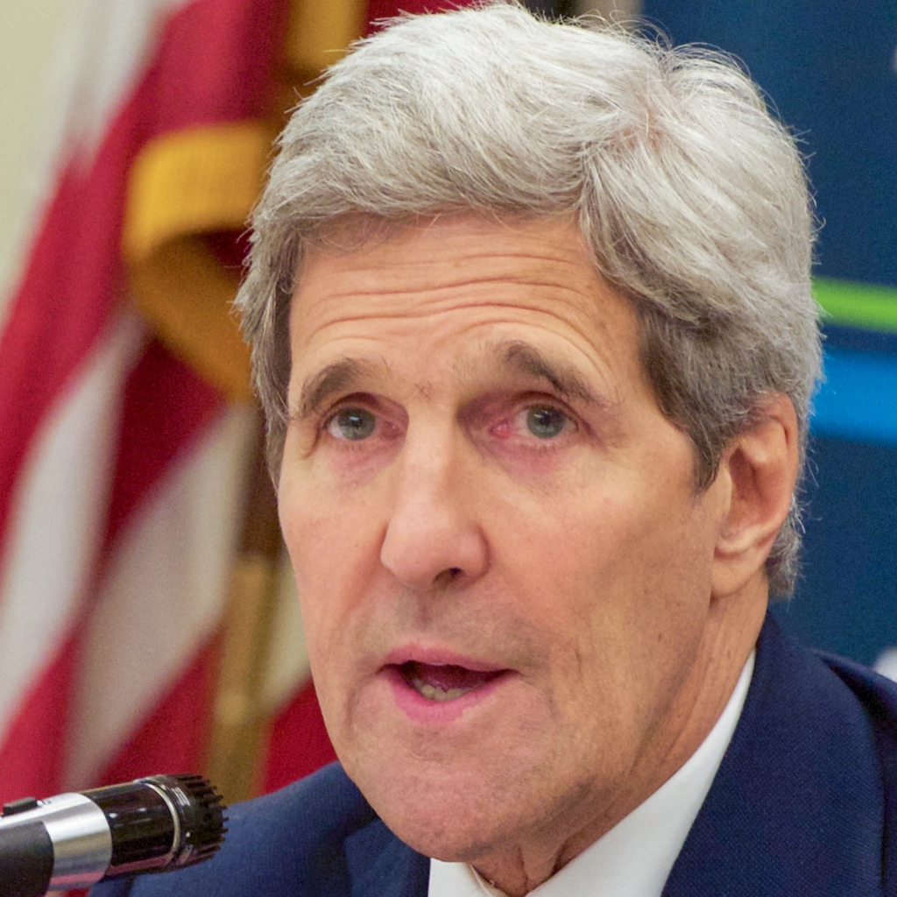

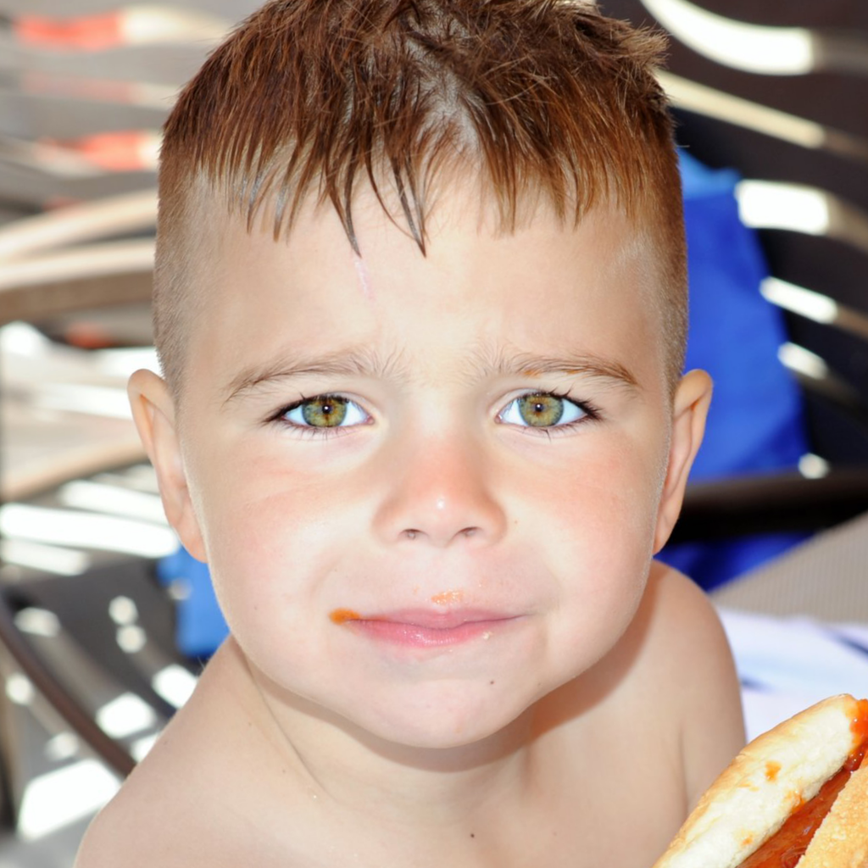
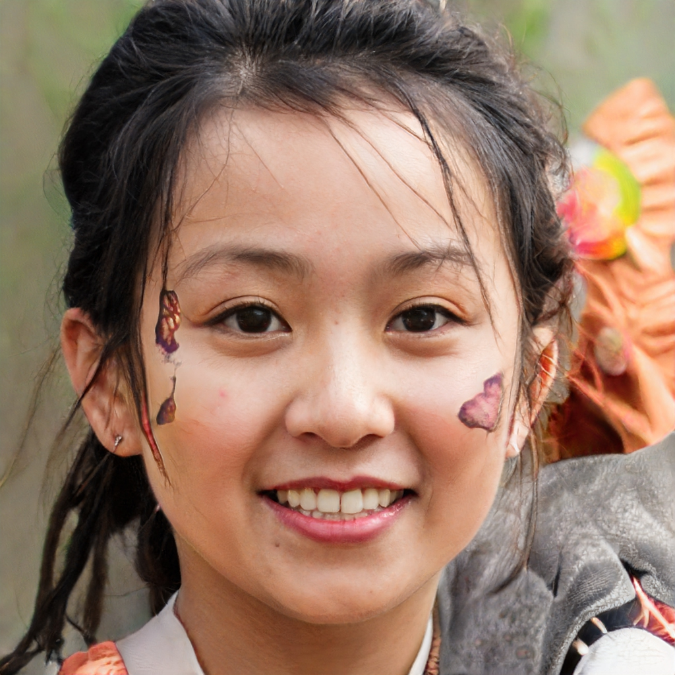
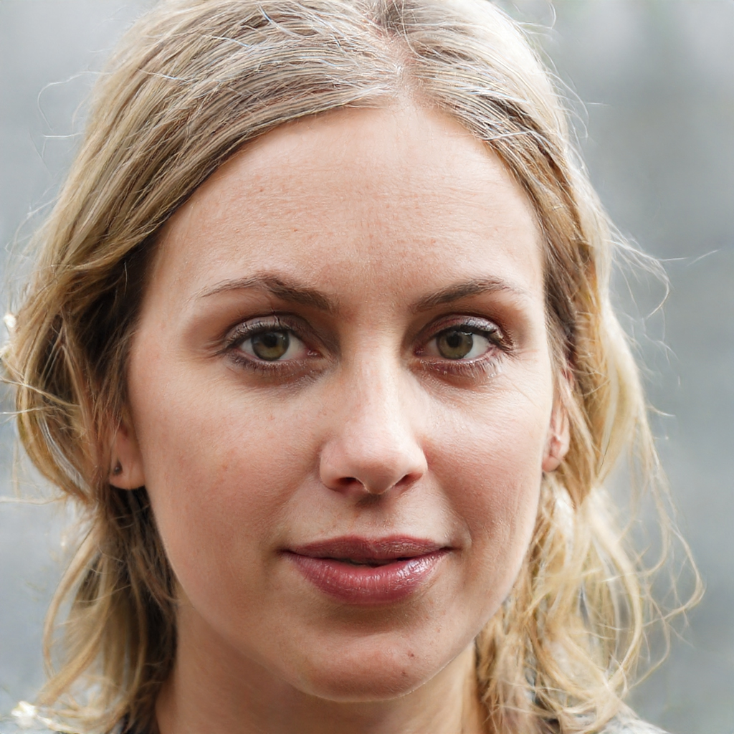

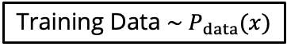
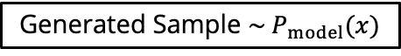
Generative Models
Definition:
Given a set of data, capture the probability distribution representing this data and generate new data samples from this distribution.
Training Data $\sim P_{data}(x)$
Generated Sample $\sim P_{model}(x)$
https://github.com/NVlabs/ffhq-dataset
https://arxiv.org/pdf/1912.04958.pdf
The objective is to learn $P_{model}(x)$ so it as close as possible to $P_{data}\left(x\right).$

Slide 5
PixelRNN
[van den Oord et al., 2016]
Explicit tractable density function.
We generate pixels one by one starting from a corner.
Dependency on previous pixels is modelled via an RNN.
During inference, for generation, we initialise the value of the first pixel and the image is generated.
Good results
but RNNs are sequential and thus inefficient!
… continue until the entire image is generated.

Slide 6
PixelCNN
[van den Oord et al., 2016]
CNN
Softmax Corss-Entropy
0-255
Explicit tractable density function.
We generate pixels one by one starting from a corner.
Dependency on pixels is modelled via a CNN over context patch.
CNN is parallelisable and thus efficient!
During inference, generation is sequential and still very slow…!
… continue until the entire image is generated.

Slide 7
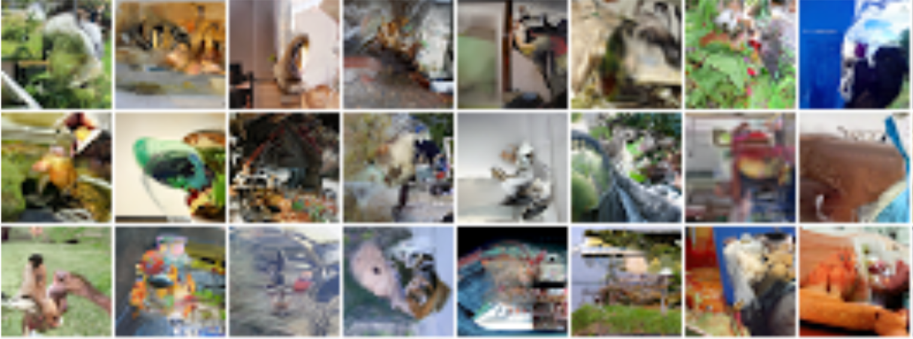
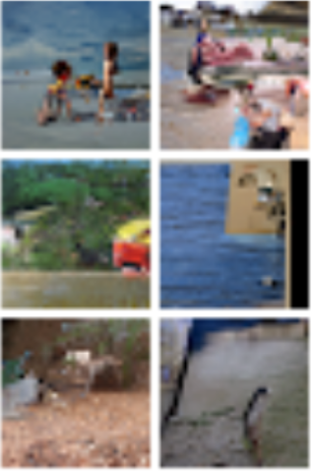
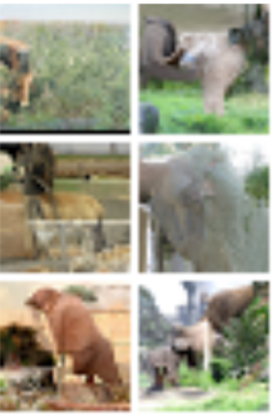
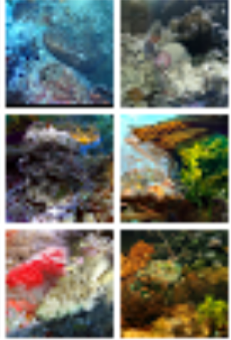
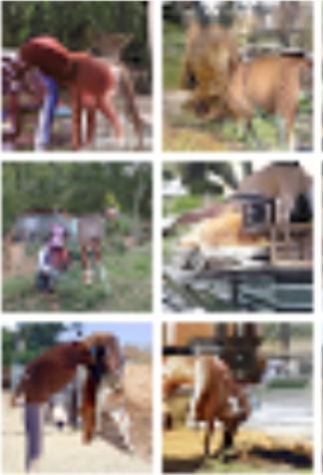
PixelRNN / PixelCNN
[van den Oord et al., 2016]
PixelRNN
PixelCNN

Slide 8
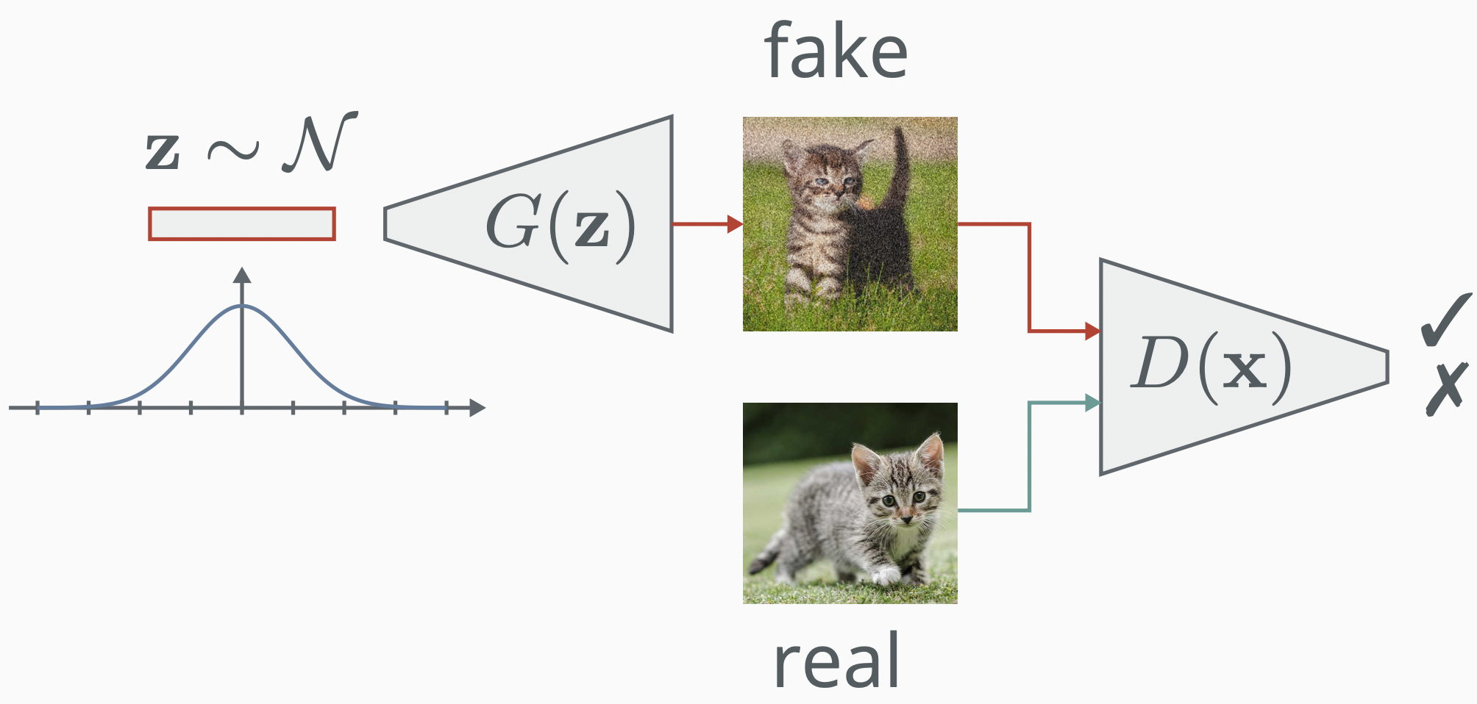
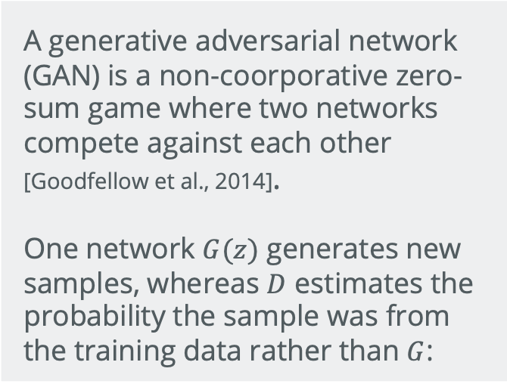
Generative Adversarial Networks
Definition:
A generative adversarial network (GAN) is a non-coorporative zero-sum game where two networks compete against each other [Goodfellow et al., 2014].
One network $G(z)$ generates new samples, whereas $D$ estimates the probability the sample was from the training data rather than $G$:
$$\min_{θ_{g}}{\max_{θ_{d}}{{ [𝔼}_{x\sim p_{data}}logD_{θ_{d}}\left(x\right)+{ 𝔼}_{z\sim p\left(z\right)}log(1−D_{θ_{d}}(G_{θ_{g}}\left(z\right))})]}$$

Slide 9




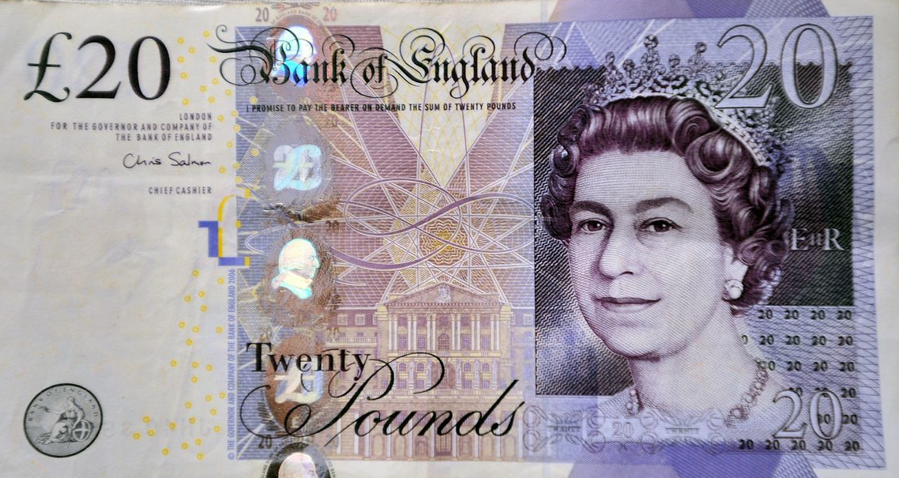

Generative Adversarial Networks
1.
Fake!
I see!!
2.
Fake!
Hmm!!
3.
Fake?
Aha!!
Generator
Real?
Discriminator
4.
Success!

Slide 10

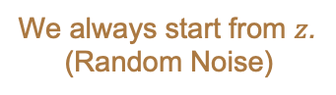
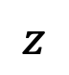
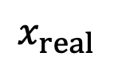
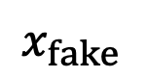
Generative Adversarial Networks
Training
We always start from $z$.
(Random Noise)
$$z$$
Ground Truth
Label: Fake
$$x_{fake}$$
Note that when the Discriminator is being trained, the weights of the Generator are not updated.
Generator
Train
$$x_{real}$$
Binary Cross Entropy Loss
First, we need to train the Discriminator:
Discriminator
1. Use a random noise vector with the Generator to produce a fake image.
Ground Truth
Label: Real
2. Use the fake image and a real image to only train the Discriminator.

Slide 11
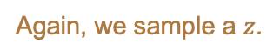
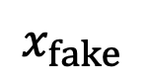
Generative Adversarial Networks
Training
Train
We continue to iteratively train both until we reach equilibrium.
Again, we sample a $z$.
Ground Truth
Label: Real
$$z$$
Generator
$$x_{fake}$$
Next, we need to train the Generator:
Binary Cross Entropy Loss
1. Use a random noise vector with the Generator to produce a fake image.
Discriminator
2. Pass the fake image through the Discriminator, but with a Real label.
3. We then use the gradients from the Discriminator to train the Generator.
Note that we are trying to fool the Discriminator, which is why the Real label is used for the fake image.

Slide 12
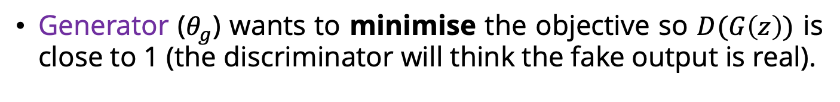
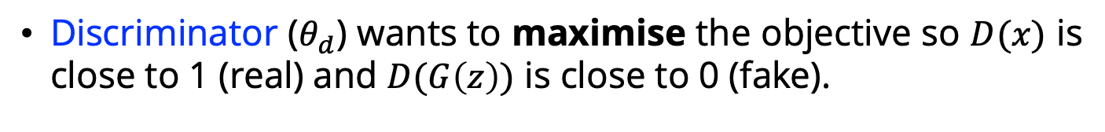
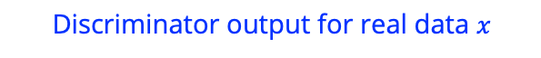
Generative Adversarial Networks
Objective
The objective function:
Generator and Discriminator are trained jointly in minimax game:
$$\min_{θ_{g}}{\max_{θ_{d}}{{ [𝔼}_{x\sim p_{data}}logD_{θ_{d}}\left(x\right)+{ 𝔼}_{z\sim p\left(z\right)}log(1−D_{θ_{d}}(G_{θ_{g}}\left(z\right))})]}$$
Discriminator output for real data $x$
Discriminator output for fake generated data $G(z)$
Discriminator ($θ_{d}$) wants to maximise the objective so $D(x)$ is close to 1 (real) and $D(G\left(z\right))$ is close to 0 (fake).
Generator ($θ_{g}$) wants to minimise the objective so $D(G\left(z\right))$ is close to 1 (the discriminator will think the fake output is real).

Slide 13
Let’s Look at Some Code!
Simple GAN Example
Code on GitHub : https://github.com/atapour/dl-pytorch/blob/main/Simple_GAN_Example/Simple_GAN_Example.ipynb
Code on Colab: https://colab.research.google.com/github/atapour/dl-pytorch/blob/main/Simple_GAN_Example/Simple_GAN_Example.ipynb

Slide 14
Generative Adversarial Networks
Issues
Issues:
Non-Convergence: Model is unstable so parameters oscillate and never converge.
Diminishing Gradients: The Discriminator reaches its optimal state too soon and its small gradients cannot train the Generator.
Hyperparameter Sensitivity: The model is too sensitive to any changes in hyperparameters (e.g., learning rate).
Mode Collapse: The Generator collapses and produces a limited variety of samples.

Slide 15
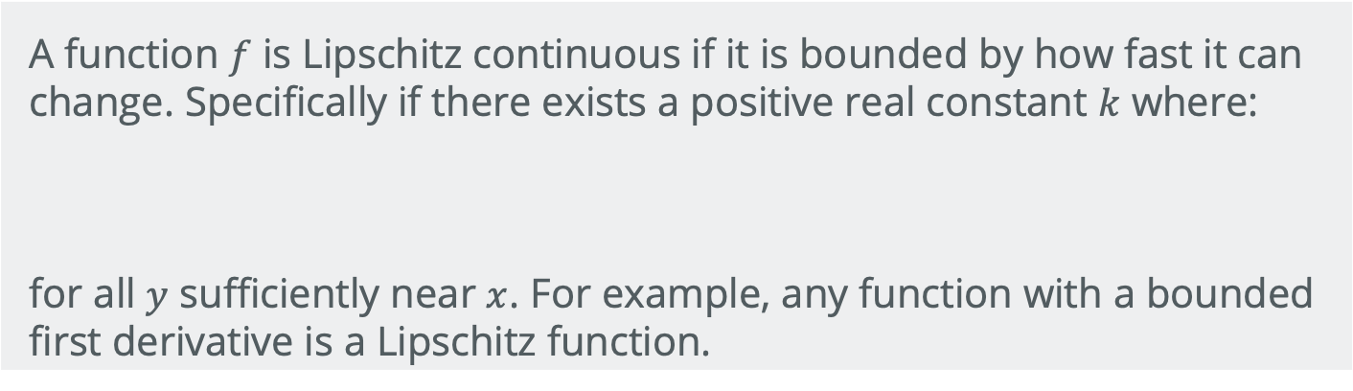
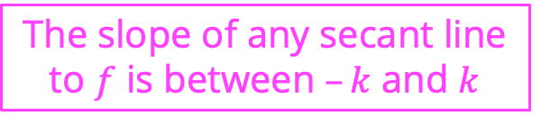
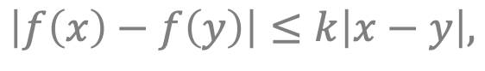
Generative Adversarial Networks
Improvements
Definition: Lipschitz function
A function $f$ is Lipschitz continuous if it is bounded by how fast it can change. Specifically if there exists a positive real constant $k$ where:
for all $y$ sufficiently near $x$. For example, any function with a bounded first derivative is a Lipschitz function.
$$\left|f\left(x\right)−f\left(y\right)\right|≤k\left|x−y\right|,$$
The slope of any secant line to $f$ is between $–k$ and $k$
Lower Lipschitz constant makes the function smooth and easy to optimise.
If the inputs $x$ and $y$ are close/similar, we want model outputs, $f(x)$and $f(y)$ to also be similar.

Slide 16
Generative Adversarial Networks
Improvements
Wasserstein GAN [Arjovsky et al., 2017]
Limiting the gradients of the discriminator will make it a smoother function.
Done by clipping the gradients.
Improved Wasserstein GAN [Gulrajani et al., 2017]
Add a penalty term to penalise the gradients of the discriminator directly.
Requires second order differentiation, which PyTorch supports, but it is slow.

Slide 17
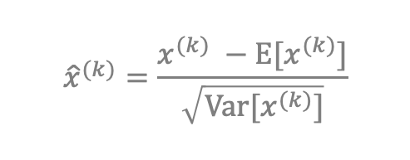
Generative Adversarial Networks
Improvements
There is another solution using Normalisation!
First, what is normalisation? – BatchNorm [Ioffe and Szegedy, 2015]
All layers are updated in the backward pass.
Every layer assumes other layers are fixed.
Backward Pass
The weights of a layer can be updated based on the expectation that the prior layer produces values with a given distribution. However, this distribution is likely to change once that layer is updated.
Forward Pass
Batch Normalisation: Layer outputs are rescaled, so they have a mean of zero and a standard deviation of one:
Problem: Internal Covariate Shift
(change in the distribution of input during training)
$${\hat{x}}^{(k)}=\frac{x^{(k)} −E[x^{(k)}]}{\sqrt{Var[x^{(k)}]}}$$
Weight Norm
Layer Norm
Instance Norm
Group Norm
Switchable Norm
Etc.

Slide 18
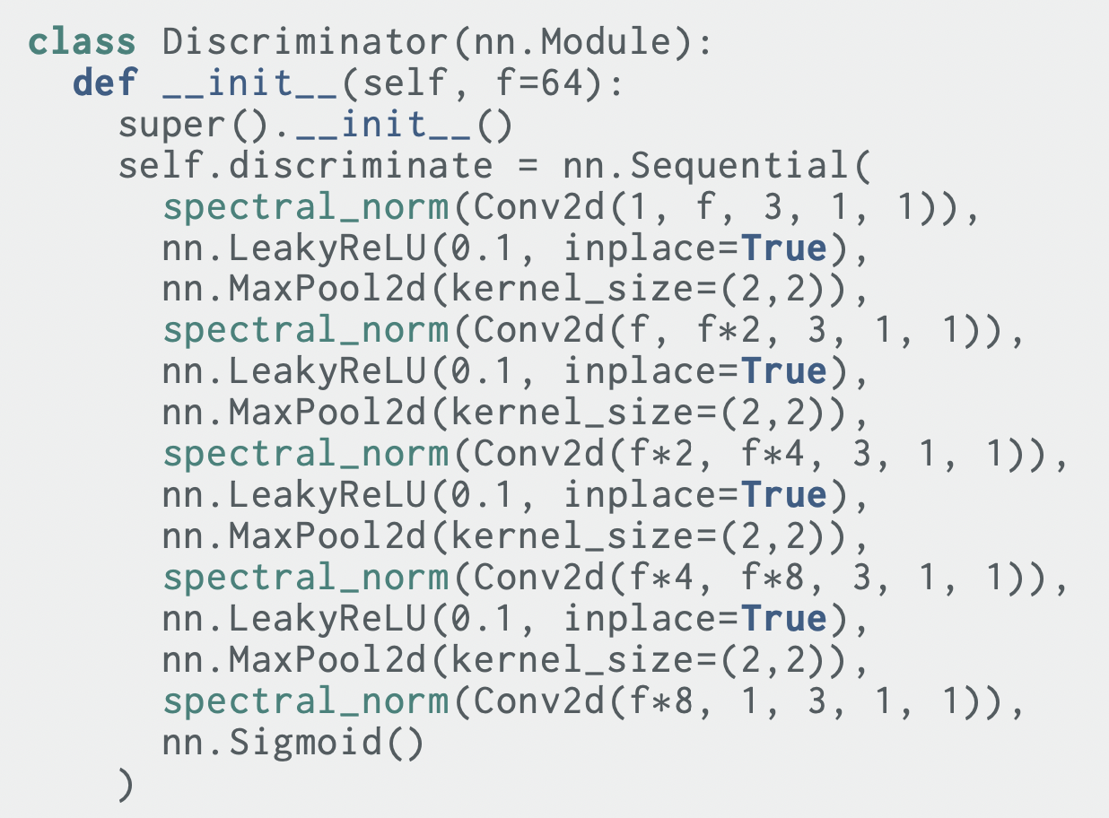
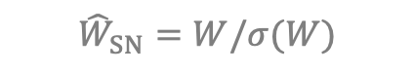
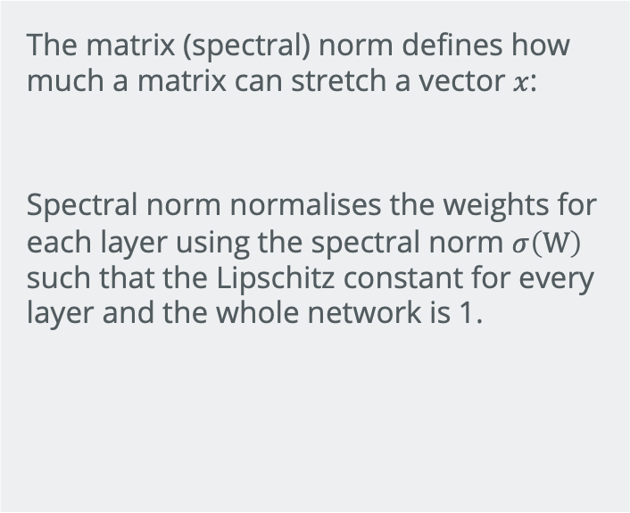
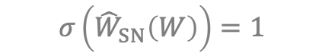
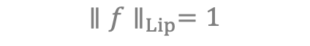
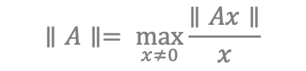
Generative Adversarial Networks
Improvements
Spectral Normalisation [Miyato et al., 2018]
Definition: spectral normalisation
Pseudocode: 1-Lipschitz discriminator
The matrix (spectral) norm defines how much a matrix can stretch a vector $x$:
Spectral norm normalises the weights for each layer using the spectral norm $σ\left(W\right)$ such that the Lipschitz constant for every layer and the whole network is 1.
$$∥A∥= \max_{x≠0}{\frac{∥Ax∥}{x}}$$
$${\hat{W}}_{SN}=W/σ(W)$$
$$σ\left({\hat{W}}_{SN}\left(W\right)\right)=1$$
$${∥f∥}_{Lip}=1$$

Slide 19
Generative Adversarial Networks
Improvements
DCGAN: The entire architecture is fully convolutional.
Alternative Objective: Wasserstein GAN - LSGAN.
Two Timescale Update: The Generator is updated more slowly than the Discriminator (SAGAN).
Stacking GANs: Multiple GANs are placed consecutively, and each GAN solves an easier version of the problem (FashionGAN).
Progressive Growing GAN: Higher quality and larger outputs by incrementally increasing the size of the model during training.
Mean squared loss

Slide 20
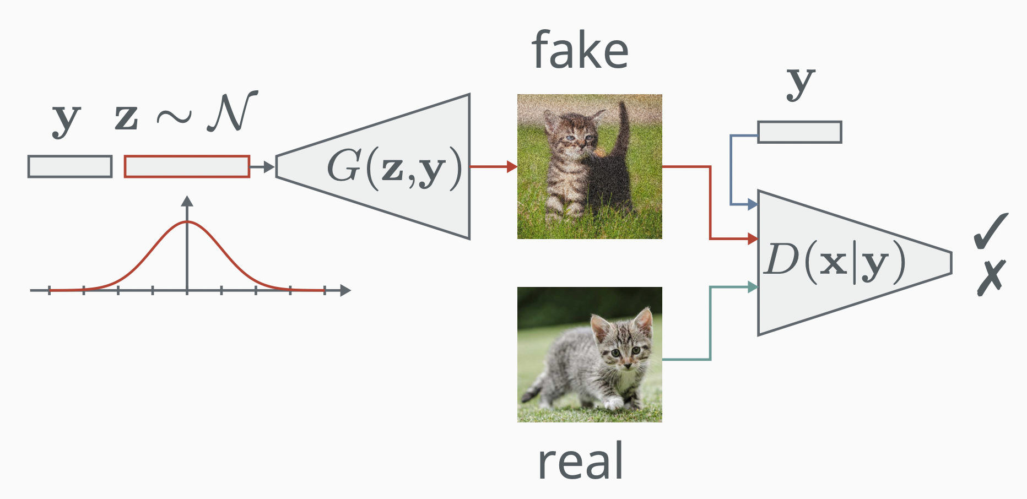
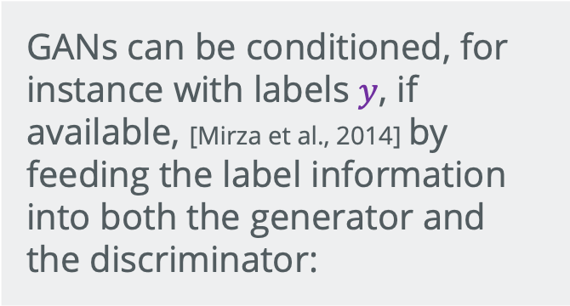
Generative Adversarial Networks
Conditional
GANS
Definition: Conditional GANs
GANs can be conditioned, for instance with labels $y$, if available, [Mirza et al., 2014] by feeding the label information into both the generator and the discriminator:
$$\min_{θ_{g}}{\max_{θ_{d}}{{ [𝔼}_{x\sim p_{data}}logD_{θ_{d}}\left(x|y\right)+{ 𝔼}_{z\sim p\left(z\right)}log(1−D_{θ_{d}}(G_{θ_{g}}\left(z,y|y\right))})]}$$

Slide 21
Let’s Look at Some Code!
Conditional GAN Example
Code on GitHub : https://github.com/atapour/dl-pytorch/blob/main/Conditional_GAN_Example/Conditional_GAN_Example.ipynb
Code on Colab: https://colab.research.google.com/github/atapour/dl-pytorch/blob/main/Conditional_GAN_Example/Conditional_GAN_Example.ipynb

Slide 22
Generative Adversarial Networks
Advanced Variants
Auxiliary Classifier GAN (ACGAN)
InfoGAN
Least Square GAN (LSGAN)
Adversarial Autoencoder
Boundary Equilibrium GAN (BEGAN)
Energy-Based GAN
StyleGAN
etc. etc. etc. …

Slide 23
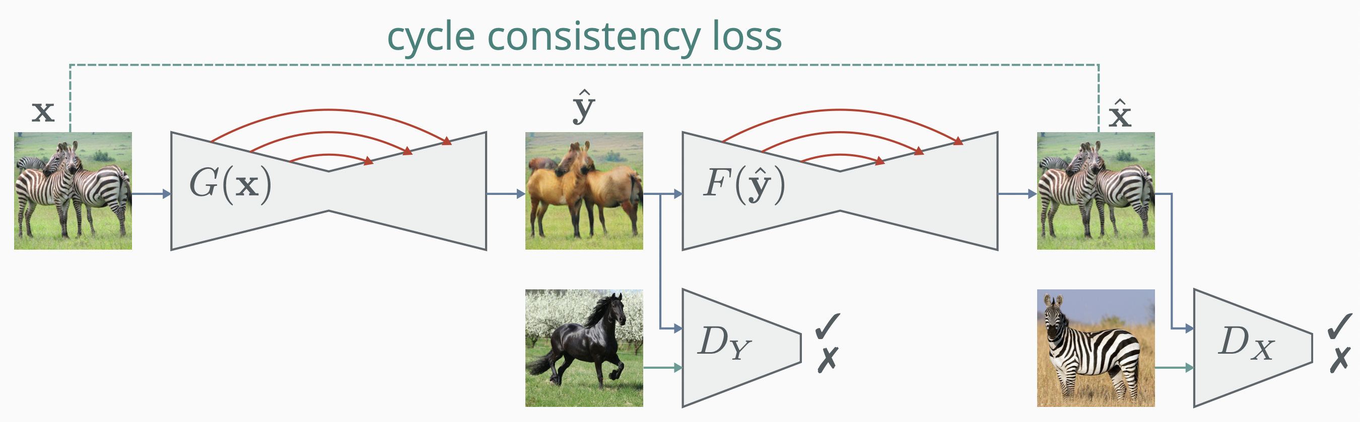

Popular Applications
Unpaired Translation (CycleGAN)
Definition: CycleGAN [Zhu et al., 2017]
An adversarial architecture for unpaired image translation. It has twin generators with skip connections and two discriminators, which translate between the domains, alongside a cycle consistency loss (L1 distance) to ensure the mapping recovers the original image.

Slide 24
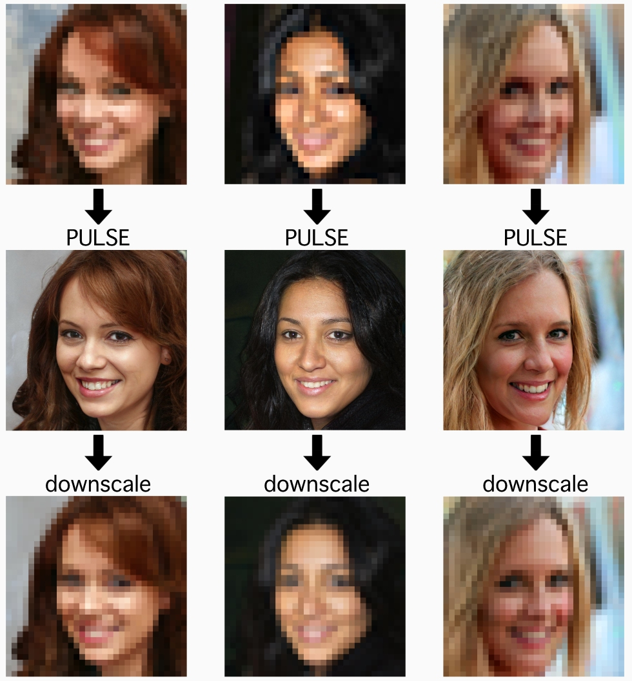
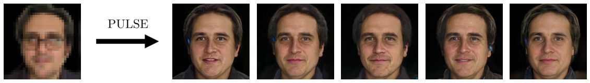
Popular Applications
Super-resolution
Definition: Super-resolution
The objective is to map a single low-resolution input to a distribution of high-resolution outputs. PULSE [Menon et al., 2020] projects points in the search of the latent space of StyleGAN (a large conditional GAN) onto a hypersphere, which ensures probable outputs in the high-dimensional latent space.
Pulse

Slide 25
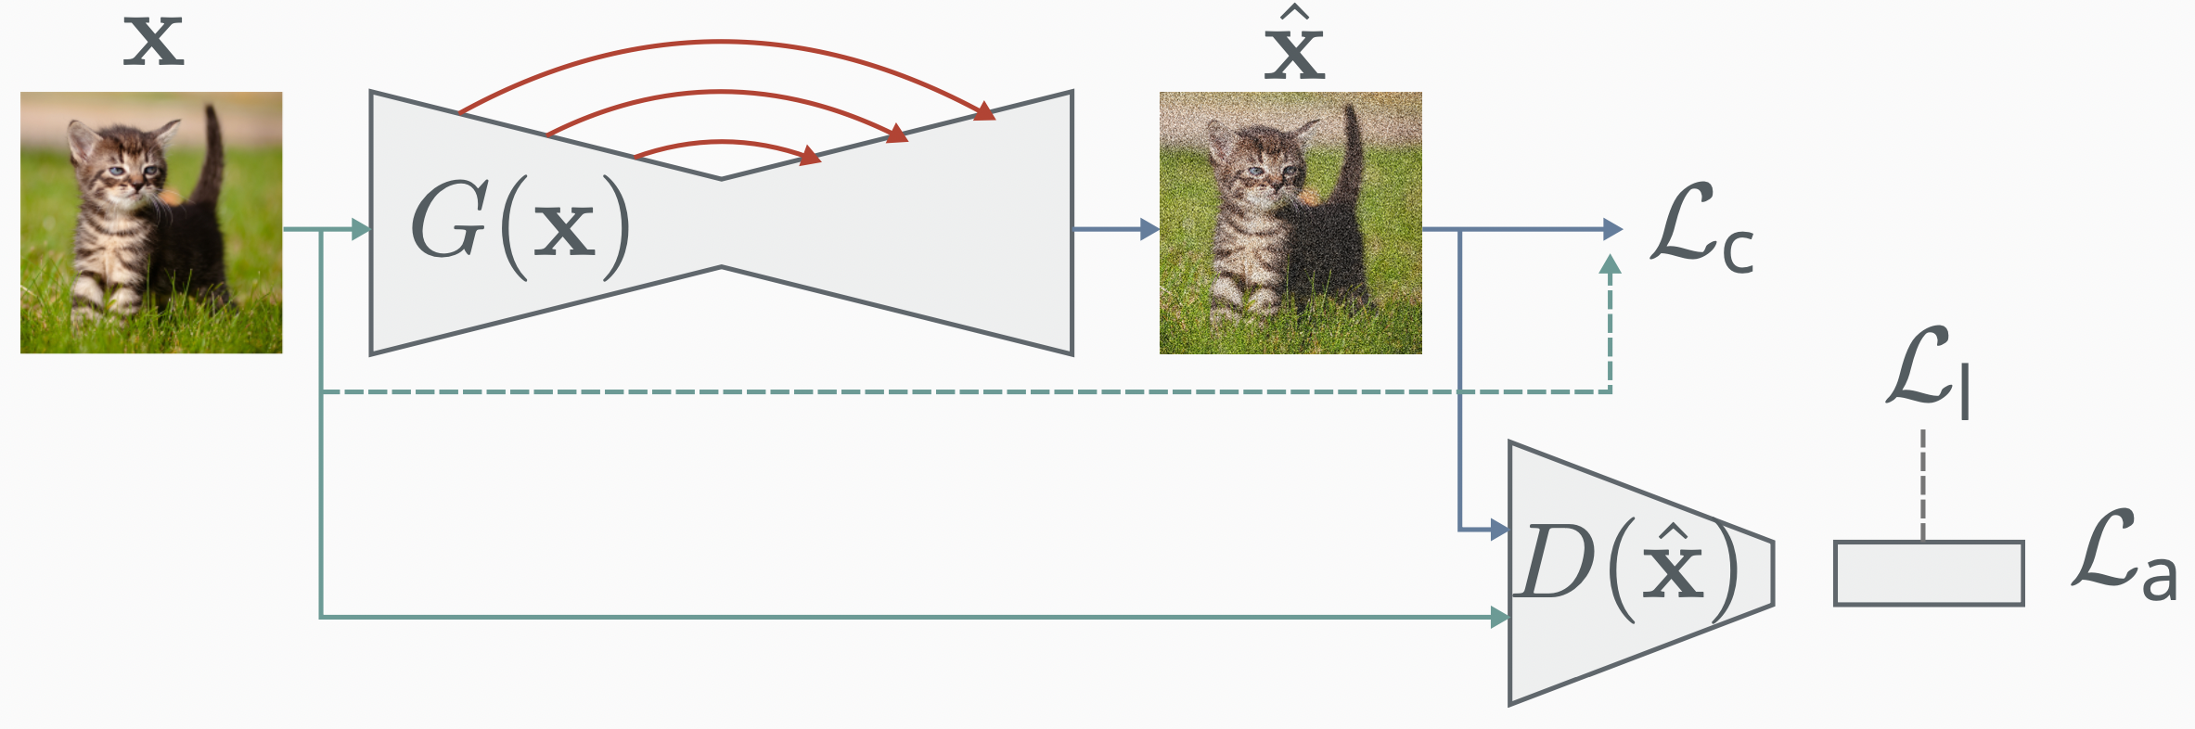
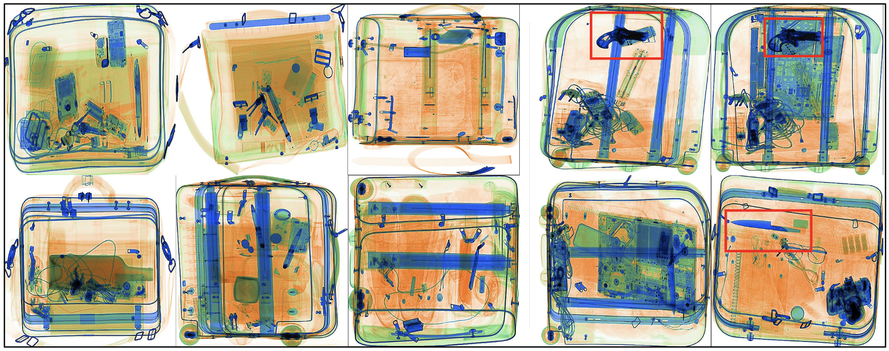
Popular Applications
Anomaly Detection
Definition: Anomaly Detection
The objective is to find “anomalies” in the data. Unsupervised anomaly detectors [1,2] learn a normal distribution over (healthy) observations. Then, when they observe something not observed in training (unhealthy/dangerous), they fail to reconstruct - detecting it as an anomaly. Region-based anomaly detectors [3] learn a distribution over inpainted (erased) regions.
[1] Akçay, Atapour-Abarghouei, and Breckon. “GANomaly: Semi-Supervised Anomaly Detection via Adversarial Training”, ACCV, 2018.
[2] Akçay, Atapour-Abarghouei, and Breckon. “Skip-ganomaly: Skip connected and adversarially trained encoder-decoder anomaly detection”, IJCNN,. 2019.
[3] Nguyen, Feldman, Bethapudi, Jennings, and Willcocks. “Unsupervised Region-based Anomaly Detection in Brain MRI with Adversarial Image Inpainting”, arXiv:2010.01942.

Slide 26
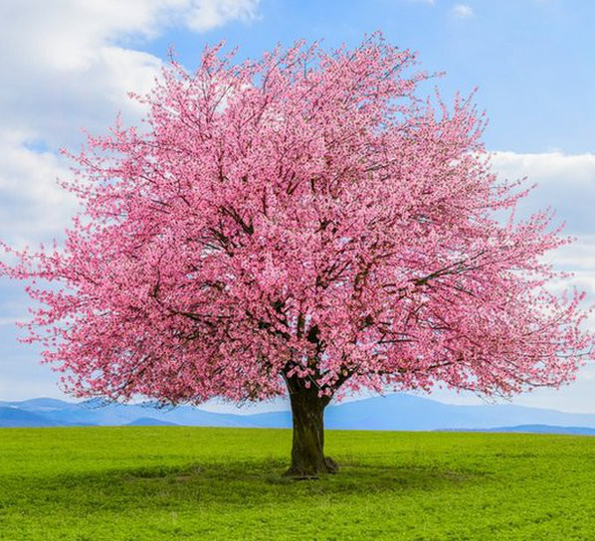


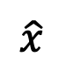






Autoencoders
Not generative models.
Designed to obtain latent variables.
Latent variables inferred by an autoencoder are a lower dimensional feature representation from unlabeled data.
variables that are not directly observed but are rather inferred (through a model)
L2 Loss: sum of the squared differences
$ℒ(x,$ $\hat{x})= ∥x, \hat{x }∥^{2}$
reconstruct the input!
$$x$$
$$\hat{x}$$
$$\hat{x}$$
$$z$$
Bottleneck
Higher dimensional $z$
Lower dimensional $z$
Encoder
Decoder

Slide 27


Autoencoders
Definition: Autoencoder
An autoencoder is a feedforward neural network that reconstructs its inputs, thus learning an identity:
$$ℒ_{AE} =E_{x∼p_{data}} [ℒ(x,D(E(x)))]$$
where$ℒ$ is a loss function. The encoder function $E : R_{n} →R_{m}$ compresses the dimensionality of the data $n ≪ m$to a latent encoding $z = E(x)$, which is then recovered by the decoder $D :R_{m}→R_{n}$, where $\hat{x} = D(z)$.

Slide 28
Autoencoders
Properties: Autoencoder
Very good at representation learning.
Are being used for data compression.
Denoising Autoencoders
Inpainting Autoencoders
Reconstruct image from a noisy input.
Reconstruct image from a input with missing regions.

Slide 29

Let’s Look at Some Code!
Example of a Simple Autoencoder
Code on GitHub: https://github.com/atapour/dl-pytorch/blob/main/AutoEncoder_Example/AutoEncoder_Example.ipynb
Code on Colab: https://colab.research.google.com/github/atapour/dl-pytorch/blob/main/AutoEncoder_Example/AutoEncoder_Example.ipynb

Slide 30





Variational Autoencoders (VAE)
[Kingma and Welling, 2013]
Explicit approximate variational density function.
Generative Models with a probabilistic spin on autoencoders.
Instead of a fixed latent vector (as in an autoencoder), VAEs learn a probability distribution in the latent space that facilitates sampling new data for generation.
$$x$$
$$\hat{x}$$
$$μ$$
$$z$$
$$σ$$
Probability
Distribution

Slide 31





Variational Autoencoders (VAE)
[Kingma and Welling, 2013]
The encoder learns:
vector $μ$ (means)
vector $σ$ (standard deviations)
The loss function will include a reconstruction loss, just like the vanilla autoencoder
Probability Distribution
the latent variables in $z$ are sampled
describe
, but there is more … .
The Encoder computes $p_{φ}(z|x)$.
The Decoder computes $q_{θ}(x|z)$.
$ℒ(x,$ $\hat{x})= ∥x, \hat{x }∥^{2}$
$$x$$
$$\hat{x}$$
$$μ$$
$$z$$
$$σ$$
Probability
Distribution

Slide 32





Variational Autoencoders (VAE)
[Kingma and Welling, 2013]
The loss function consists of two terms:
Reconstruction Loss ($L_{2}$ loss)
KL Divergence
$$ℒ\left(φ,θ;x,z\right)=𝔼_{q_{φ}(z|x)}\left[logp_{θ}\left(x | z\right)\right]−D_{KL}(q_{φ}\left(z | x\right)∥p\left(z\right))$$
Expectation: we are dealing with random variables
Kullback–Leibler divergence: measure of how one probability distribution is different from another
Reminder: summation or integration of all possible values from a random variable
$$x$$
$$\hat{x}$$
$$μ$$
$$z$$
$$σ$$
The Encoder $q_{φ}(z|x)$.
The Decoder $p_{θ}(x|z)$.
Probability
Distribution

Slide 33

Variational Autoencoders (VAE)
[Kingma and Welling, 2013]
We want the probability distribution to be smooth and not to overfit or memorise any of the latent variables within vector $z.$
$$ℒ\left(φ,θ;x,z\right)=𝔼_{q_{φ}(z|x)}\left[logp_{θ}\left(x | z\right)\right]−D_{KL}(q_{φ}\left(z | x\right)∥p\left(z\right))$$
By reducing the distance between the probability distribution and a well-behaved prior distribution (such as a Normal Gaussian), we:
encourage the latent variables to be evenly distributed around the centre of the latent space
and deter the model from clustering points in specific regions and cheat by memorising the data.

Slide 34


Variational Autoencoders (VAE)
[Kingma and Welling, 2013]
Definition: Kullback–Leibler divergence
The Kullback-Leibler divergence (also called relative entropy) measures the difference between distributions and is asymmetric and non-negative:
$$D_{KL}(p∥q)=\int{p\left(x\right)\log\left(\frac{p\left(x\right)}{q\left(x\right)}\right)dx}$$
Where $D_{KL}\left(p∥p\right)=0.$Practically, the KL divergence is sensitive at the tails of the distribution.
Desmos Visualisation:
https://www.desmos.com/calculator/2sboqbhler
Notes:
Forward pass through time => backward pass through time
Gradients accumulate in W additively
Different length sequences:
Batch similar length sequences
Pad to same length
Mask extra outputs
Problematic for very long sequences (e.g. long wikipedia article/audio). Memory scales linearly with time. Also really slow
Truncated BPTT
Step forward in time for some number of steps. Loss over sub sequence. Backprop over subsequence
Next part of sequence, keep hidden state connections. Only backprop through smaller batch.
Comparable to stochastic gradient descent. Don’t use whole of dataset, use minibatches.

Slide 35

Variational Autoencoders (VAE)
[Kingma and Welling, 2013]
Let’s visually inspect how regularisation with the KL term helps.
We can analyse the effect of the KL term by weighting the loss and experimenting with different values:
loss = reconstruction_loss + c * kl_loss
We will consider an autoencoder with a latent space of 2 dimensions trained on the MNIST dataset.
For reference, let’s look at points sampled from the standard Gaussian in two dimensions.

Slide 36






Variational Autoencoders (VAE)
[Kingma and Welling, 2013]
We can see how the points begin to cluster with no or a small kl_loss.
C = 0.0
C = 0.02
C = 0.1
C = 0.5
C = 1.0
C = 2.0
https://www.vincent-lunot.com/post/on-the-use-of-the-kullback-leibler-divergence-in-variational-autoencoders/

Slide 37







Variational Autoencoders (VAE)
[Kingma and Welling, 2013]
Issue to overcome: backpropagation through a sampling layer
Solution: Reparameterisation Trick
Forward Pass
$$z=μ+σ ⨀ε$$
where$ε\sim 𝒩(0,1)$
$$μ$$
$$z$$
$$σ$$
$z$ will be a sum of a fixed vector $μ$ and a fixed vector $σ$ scaled by random constants $ε$ sampled from the prior distribution (standard Gaussian).
$$z\sim 𝒩(μ,σ)$$
Backward Pass

Slide 38









Variational Autoencoders (VAE)
[Kingma and Welling, 2013]
Reparameterisation Trick
$$f$$
$$f$$
Backward Pass
Backward Pass
$$z$$
$$z$$
Deterministic
Forward Pass
Forward Pass
✓
$$μ$$
$$σ$$
$$μ$$
$$σ$$
$$ε$$
Stochastic
Original Form
Reparameterised Form

Slide 39


Variational Autoencoders (VAE)
[Kingma and Welling, 2013]
Definition: Evidence Lower Bound (ELBO)
VAEs have three components:
The decoder $p_{θ}\left(x | z\right)$
The approximate posterior (encoder) $q_{φ}\left(z | x\right)$
The prior distribution $p_{θ}(x)$
They are trained with the reparameterisation trick to maximise the evidence lower bound (ELBO):
$$\log{p_{θ}(x) ≥}𝔼_{q_{φ}(z|x)}\left[logp_{θ}\left(x | z\right)\right]−D_{KL}(q_{φ}\left(z | x\right)∥p\left(z\right))$$
There are more advanced and state-of-the-art method, such stacking VAEs hierarchically [Child et al., 2021].
Notes:
Forward pass through time => backward pass through time
Gradients accumulate in W additively
Different length sequences:
Batch similar length sequences
Pad to same length
Mask extra outputs
Problematic for very long sequences (e.g. long wikipedia article/audio). Memory scales linearly with time. Also really slow
Truncated BPTT
Step forward in time for some number of steps. Loss over sub sequence. Backprop over subsequence
Next part of sequence, keep hidden state connections. Only backprop through smaller batch.
Comparable to stochastic gradient descent. Don’t use whole of dataset, use minibatches.

Slide 40


Variational Autoencoders (VAE)
[Kingma and Welling, 2013]
Head Pose
Results
The latent variables are forced to be independent of each other.
Smile
Different dimensions of $z$ encode interpretable factors of variation.

Slide 41
Let’s Look at Some Code!
Example of a Variational Autoencoder
Code on GitHub: https://github.com/atapour/dl-pytorch/blob/main/VAE_Example/VAE_Example.ipynb
Code on Colab: https://colab.research.google.com/github/atapour/dl-pytorch/blob/main/VAE_Example/VAE_Example.ipynb

Slide 42


Implicit Models
Definition
Definition: implicit representations
Consider data $Φ: ℝ^{m}→ℝ^{n}$, like a single image, as a function of coordinates $c∈ℝ^{m}$. The aim is to learn a neural approximation of $Φ$ that satisfies an implicit equation:
$$R\left(c,Φ,∇_{Φ},∇_{Φ}^{2},…\right)=0, Φ:c→Φ(c)$$
This has applications in 3D modelling, image, video, audio representation.
Example: Implicit Network

Slide 43








Implicit Models
$$c∈ℝ^{2}$$
$$x∈ℝ^{3}$$
Image
Image
$$Φ$$
coordinates – $(x,y)$
pixel value – $\{R,G,B\}$
Neural Network
$$Φ$$
We can have a neural network approximate the image function.
$$c$$
$$x$$

Slide 44

Implicit Representation Networks
SIREN
Definition: SIREN
SInusoidal REpresentation Networks (SIREN) are a simple implicit representation network, but use sin (with clever initialisation) as their choice of non-linearity [Sitzmann et al., 2020].
sin is periodic, so it allows to capture patterns over all of the coordinate space (translation invariant, like convolutions).
Example: SIREN
https://www.vincentsitzmann.com/siren

Slide 45


Implicit Representation Networks
NeRF
Definition: NeRF
Example: NeRF
Neural Radiance Fields (NeRF) are similar to SIRENs, but instead of representing an image, they represent a single 3D scene [Mildenhall et al., 2020].
They map from pixel positions $(x,y,z)$ and a viewing direction $(θ,φ)$ to a colour and density value $σ$ integrated via a ray on $F_{θ}$.
https://www.matthewtancik.com/nerf
There are other implicit models:
https://cwkx.github.io/data/GON/

Slide 46
What we learned today!
Unsupervised training
PixelRNN and PixelCNN
Generative models
Generative adversarial networks
Definition
Common Issues
Lipschits Continuity
Spectral Normalisation
Conditional GANs
Other Advanced Variants
Variational autoencoders
Autoencoders
VAEs
Reparameterisation trick
ELBO
Implicit networks
Definition
SIRENs
NeRFs

